Slide 1
Bezier Curves
Franklin Liu

Slide 2
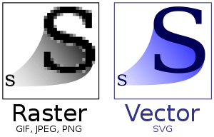
Introduction
Raster images
  grid of pixels
Vector images
  Geometric shapes, curves

Slide 3
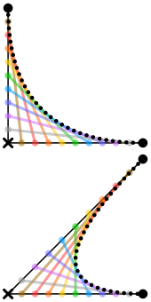
Bezier curves
Discovered independently by Paul de Casteljau and Pierre Bezier
Uses control points to determine its shape
Can also be represented as polynomials

Slide 4
De Casteljau’s algorithm
Simplest case: 3-point curve (quadratic)
From javascript.info:
  Draw control points.
  Build segments between control points 1 → 2 → 3.
  The parameter t moves from 0 to 1.
  For each of these values of t:
    On each segment we take a point located on the distance proportional to t from its beginning. As there are two segments, we have two points.
    At t=0 – both points will be at the beginning of segments, and for t=0.25 – on the 25% of segment length from the beginning, for t=0.5 – 50%(the middle), for t=1 – in the end of segments.
  Connect the points to get a curve
Demo
https://pomax.github.io/bezierinfo/#whatis
https://javascript.info/bezier-curve#de-casteljau-s-algorithm

Slide 5
What about more control points?
4-point curve:
From javascript.info:
  Connect control points by segments: 1 → 2, 2 → 3, 3 → 4. There will be 3 brown segments.
  For each t in the interval from 0 to 1:
  We take points on these segments on the distance proportional to t from the beginning. These points are connected, so that we have two green segments.
  On these segments we take points proportional to t. We get one blue segment.
  On the blue segment we take a point proportional to t. On the example above it’s red.
  These points together form the curve.
Demo: https://javascript.info/bezier-curve#de-casteljau-s-algorithm

Slide 6

Polynomial Representation
For 3-point curve:
  p1 is first point, p2 is second, etc
  Parametric equation: P = (1-t)²p1 + 2(1-t)t p2 + t²p3
Berenstein polynomials
Demo: https://www.desmos.com/calculator/xfc7hu3cob

Slide 7
How to get the polynomial form
(for quadratic bezier curves)
First the linear interpolations
Expand and rearrange in terms of t and 1-t
You can also rearrange for more symmetry:

Slide 8
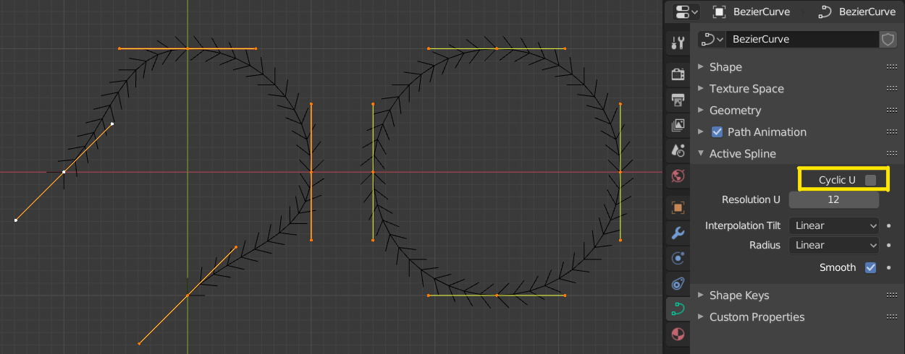
Applications
Images (SVG)
Animation (CSS Transitions)
CAD/3D Modeling
Digital Art
Fonts

